Slide 1
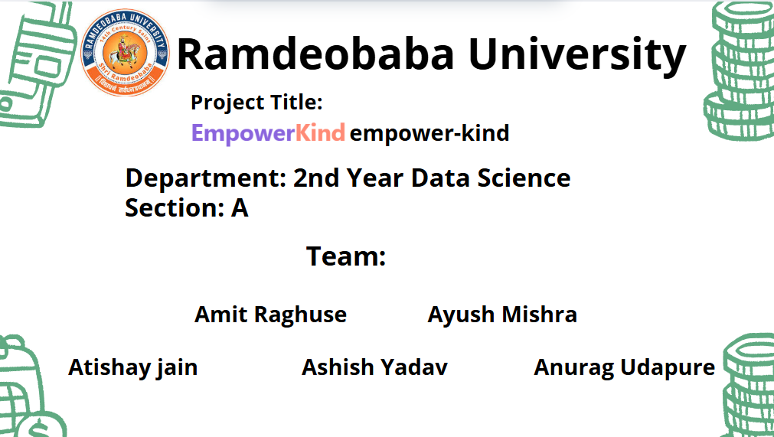

Slide 2
Introduction
Purpose of the Project
The initiative aims to build a safe, user-friendly platform connecting donors with children with special needs. This platform enables individuals and organizations to donate money, items, or services to improve opportunities and quality of life for children with special needs.
Why this Community/Organization was Chosen
We decided to focus on children with special needs after visiting a workshop for mentally challenged students. This visit was impactful, as we saw children learning essential skills like crafts, vocational tasks, and personal care, fostering their independence and dignity.
Though commendable, these institutions often face shortages in funding, resources, and recognition. This motivated us to create a solution that directly supports them.
Objectives of the visit
To explore the challenges of specially abled children and their support institutions.To assess how skill-based learning fosters self-reliance.Identifying how donations, whether monetary or material, directly enhance facilities and personal growth.To securely and transparently link donors with communities.

Slide 3
Abstract
Visited Matru Sewa Sangh (MSS), Nagpur, to understand the needs of specially-abled children and the challenges faced by NGOs in resource mobilization.
Identified a gap in structured donation systems—many willing donors lack a reliable channel to contribute meaningfully.
Proposed a digital solution: a secure, centralized platform to facilitate donations (money, items, services) to support such NGOs.
The platform connects individuals and organizations directly with verified NGOs, ensuring transparency and ease of contribution.
Expected impact: consistent donor engagement, improved support for specially-abled children, and stronger community participation in inclusive development.

Slide 4
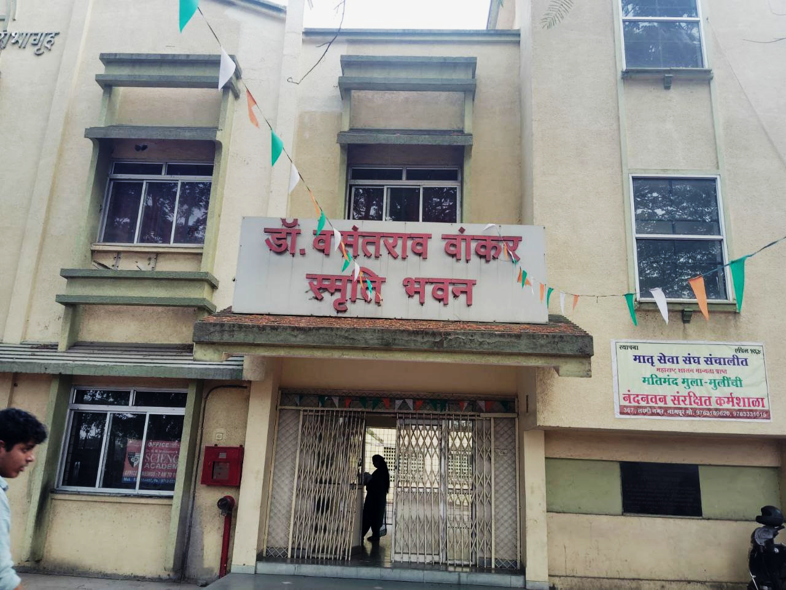
About the Organization:
Organization Name: Matru Sewa Sangh (MSS) Nandanvan Residential School & Sheltered Workshop
Focus Area: Supports intellectually Divyang (specially-abled) children through education, care, and skill-building.
Location: 367, Laxmi Nagar, Dikshabhoomi, Nagpur – 440022
NGO VISITED
The school caters to 200 children of school-going age. It admits mentally retarded children between the ages of 6 years and 18 years. These children are educated according to their capacities and pre-vocational training is imparted to them.
In April 1999, Nandanvan added an early intervention unit to its facilities. Mentally Retarded children between the ages of 4 and 6 years are put through a skill development program aimed at improving their motor skills and making them independent. The proper education, training and rehabilitation of these children started only after VRA (Vocational Rehabilitation Administration) project started in the year 1964 led by Late Dr. Kusum Wankar as project incharge. Presently 130 students are in the school of which 35 stay in the hostel.

Slide 5
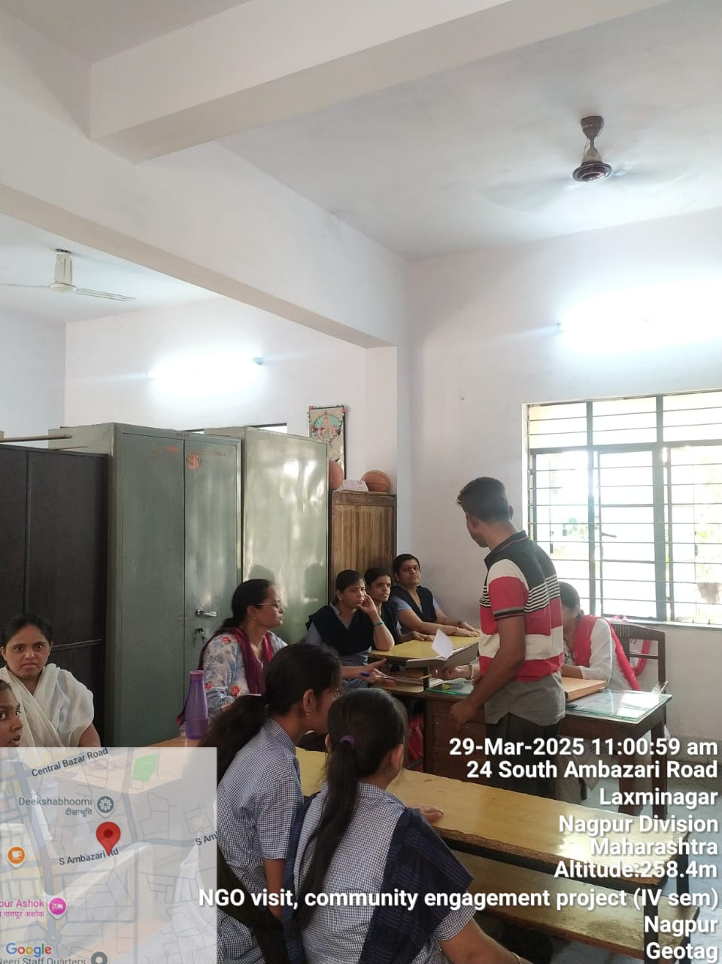
Problem Identification
Lack of structured donation channels
Limited awareness about needs of specially-abled children
Trust and transparency concerns
Irregular support to NGOs
Focused Problem:
No dedicated, secure platform to connect donors with these children.

Slide 6
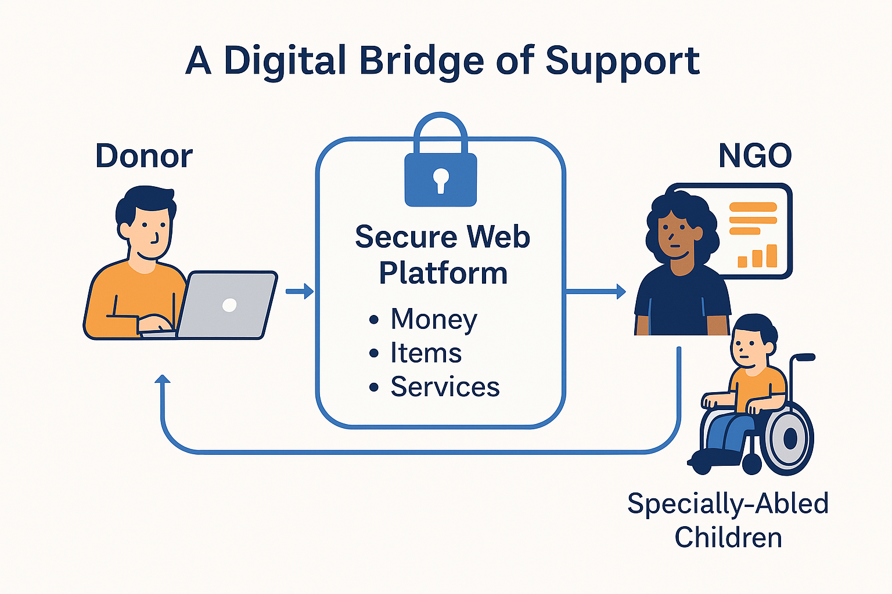
A Digital Bridge of Support
Flowchart
Our Solution: A secure web-based platform for donations (money, items, services).
Technologies Used:
Website (Frontend: React, Backend: Node.js)
Database (MongoDB)
Payment Gateway Integration
Admin Dashboard for NGOs
.

Slide 7
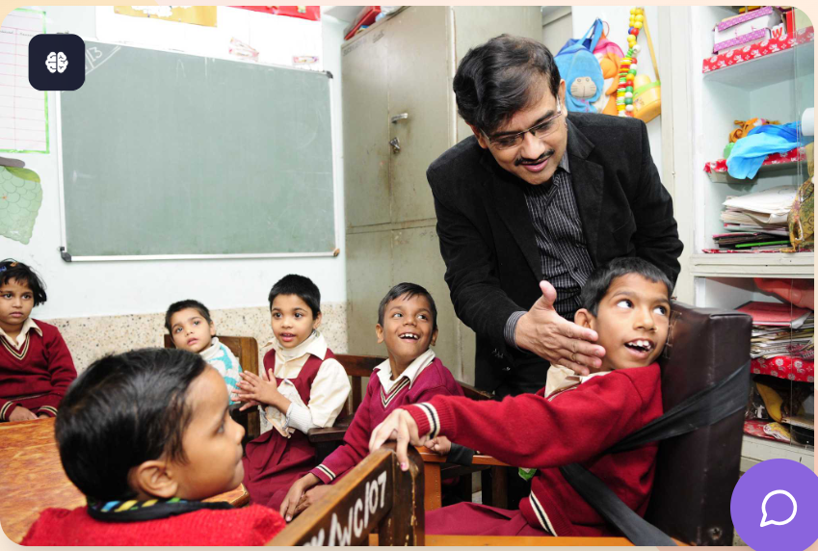
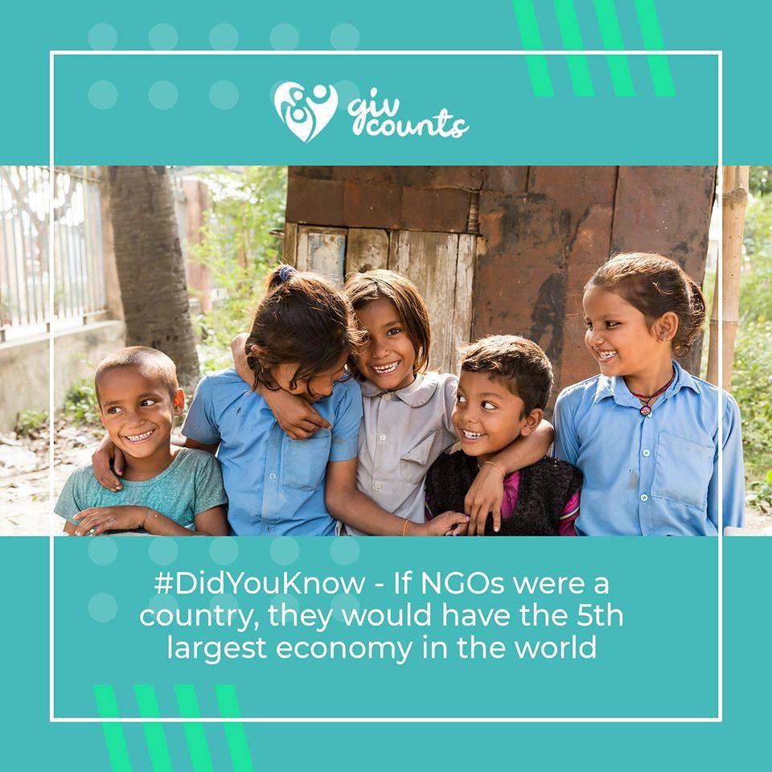
Challenges Faced During Implementation:
1. Building Trust and Transparency:
2. Coordinating with Multiple NGOs:
One of the key challenges was ensuring that donors trust our platform. We had to implement proper tracking mechanisms to show where and how their donations are being used, which required both technical and operational effort.
Collaborating with different NGOs was challenging due to varying workflows, communication gaps, and data-sharing issues. Standardizing the donation process across organizations required extra planning and customization.

Slide 8
Community Impact – “Technology with a Heart”
🔹 How It Helps MSS:
Streamlined Donations: MSS can now receive funds, essential items, and service offers through a single digital platform.
Consistent Support: Automated reminders and outreach features promote regular donations.
Increased Visibility: The platform helps MSS showcase its work, needs, and impact stories to a wider audience, including potential long-term donors.
🔹 Benefits to the Community:
Empowered Children: More reliable support means better education, nutrition, healthcare, and emotional care for Divyang children.
Wider Participation: Individuals and corporates can easily browse needs and contribute in various ways (money, volunteering, goods).
Transparent Giving: Real-time donation tracking and NGO feedback build trust and accountability in the donation process.

Slide 9
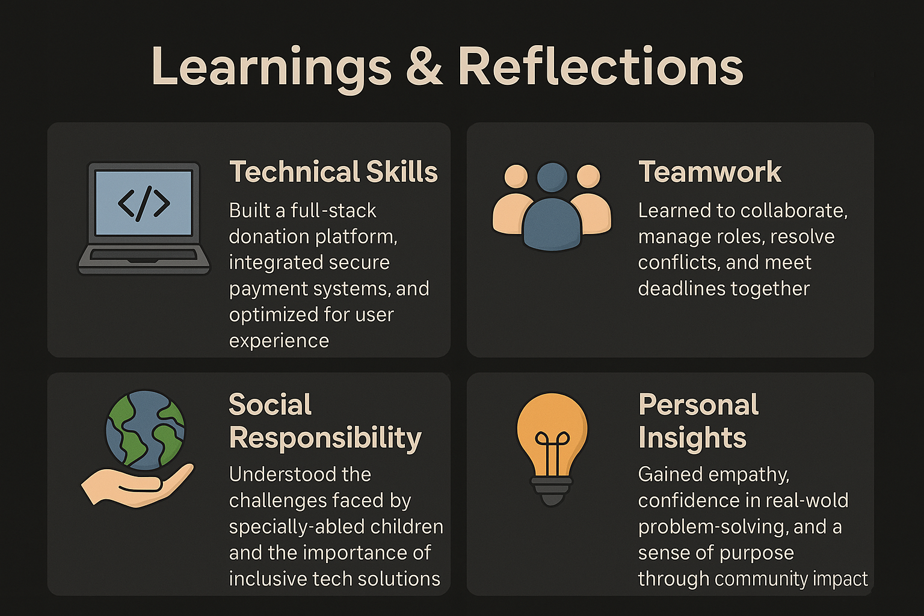
Learnings & Reflections – “Beyond the Code”

Slide 10
Conclusion
✅ Summary of the Work
🔮 Scope for Further Development
We identified a critical gap in how specially abled children receive support
Our solution: a secure, inclusive online donation platform for individuals and organizations to offer help in the form of money, essential items, or services.
The platform emphasizes transparency, ease of use, and real-world impact by directly connecting donors with verified institutions and children in need.
Mobile App Integration to increase accessibility on smartphones.
Adding AI-based donor recommendations (e.g., showing where help is needed most based on user interests).
Real-time donation tracking and updates for donors.
Support for in-kind service donations (like therapy sessions, educational training, etc.).
♻️ Sustainability & Future Improvements
Partnering with local NGOs and government initiatives for continuous support and verification.
Launching awareness campaigns and donation drives through social media and corporate CSR tie-ins.

Slide 11

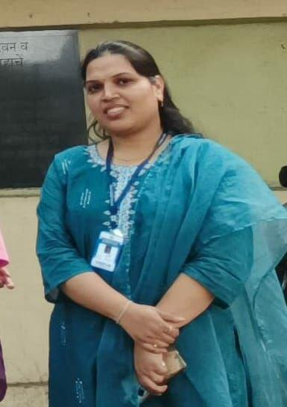
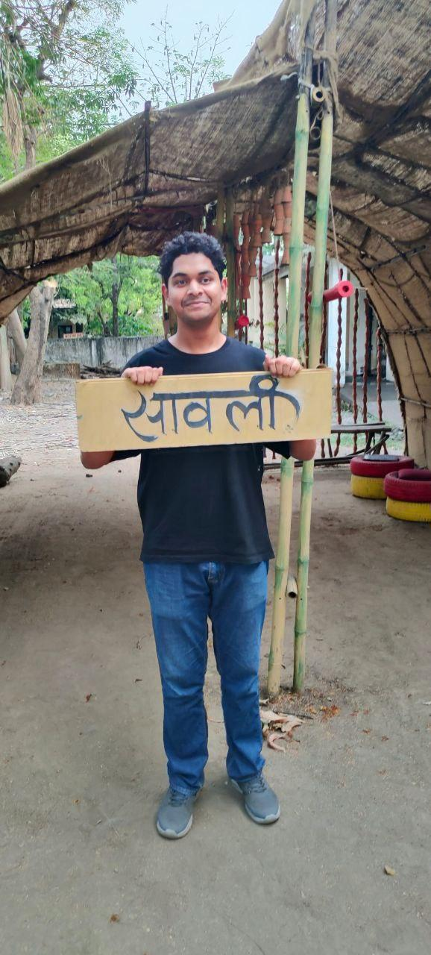
Acknowledgment
Matru Sewa Sangh (MSS)
Nandanwan Residential School & Sheltered Workshop
For giving us the opportunity to visit, interact, and understand the challenges and strengths of specially abled children. Your efforts in empowering these young minds deeply inspired our project.
Sonam Meshram
Ma’am
For being our mentor and guiding light throughout this project. Your valuable insights, encouragement, and unwavering support helped us shape our ideas and present them with purpose.
Volunteers
For assisting with arrangements, field visits, and documentation — your contributions were vital in bringing this project to life.
Join us and create real change!

Slide 12

Question and answer session

